Slide 1
Paper Review: An Efficient Performance Testing of Web Services
Luke Daniel and Luke Farthing

Slide 2

Overview
This paper proposes an equation for assessing the strength of load testing approaches using data gathered from open-source testing software (Apache JMeter).
The authors used 5 different Web Service data sets to evaluate their approach using this method.
"We use these metrics to propose the APM metric for assessing the strength of our proposed load testing approach."

Slide 3

Introduction
Performance engineering is an essential part of the software development lifecycle (SDLC).
Performance problems for web applications commonly occur when users encounter high response times and latency rates when under significant load.

Slide 4

Apache JMeter
Apache JMeter is an open-source software tool designed to test functional behavior and to measure the performance of web applications.
In this paper, the authors use JMeter to gather test data that they will eventually use when calculating final APM scores.

Slide 5

Load Testing
Load Testing is the method by which Apache JMeter evaluates web services and their performance.
How well can the service handle aggressive increases in user count and transactions?

Slide 6
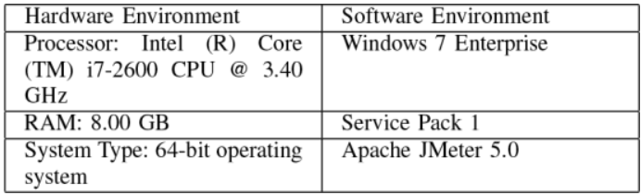
Before You Go
An essential step in preparing for Load Testing using Apache JMeter, determine the hardware and software specifications that all tests will be run on.
If hardware and software varies, performance evaluations will vary.
The authors of the paper used this setup:

Slide 7
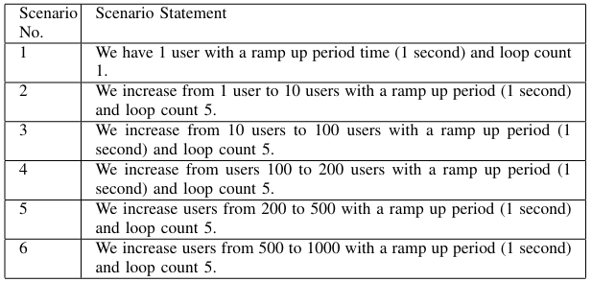
Experimental Setup

Slide 8
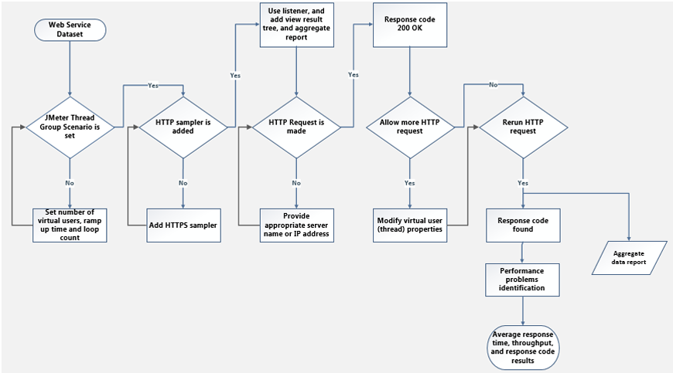
JMeter Test Approach

Slide 9
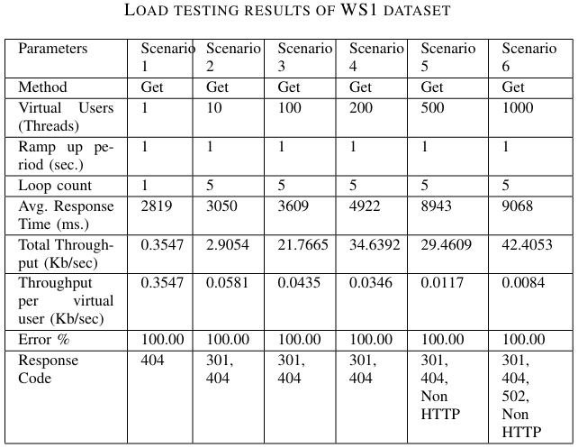
Test Results
The metrics that resulted from these tests included sample count, response time, error %, throughput, and received and sent data.
Fault messages from JMeter were also recorded for later use in APM calculations.

Slide 10
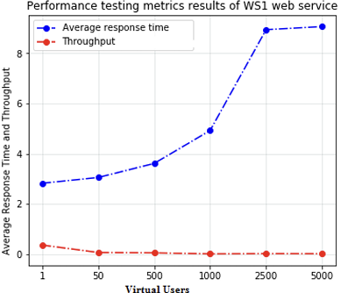
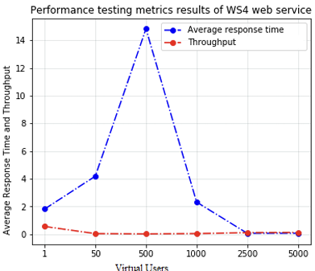
Test Results (cont.)

Slide 11
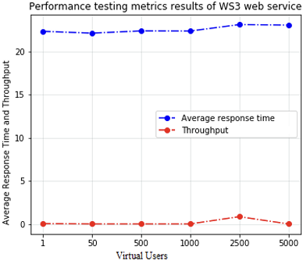
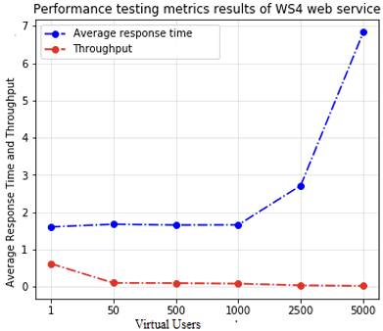
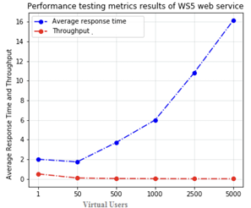
Test Results (cont.)

Slide 12
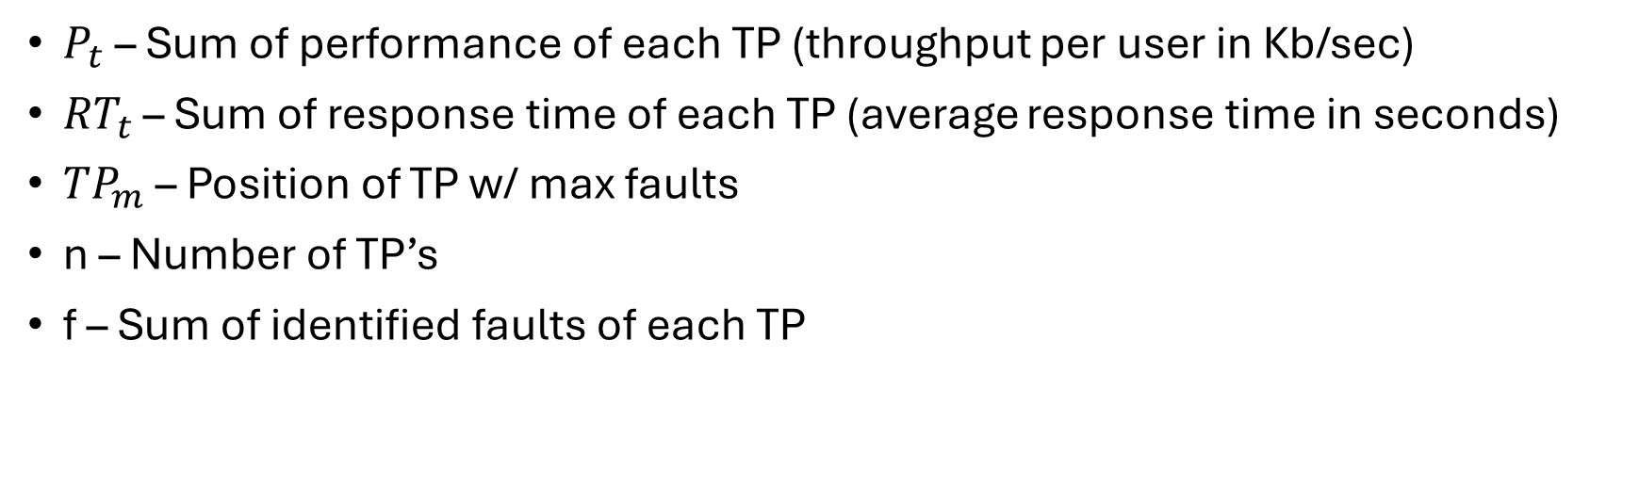
Calculating APM
$P_{t}$ – Sum of performance of each TP (throughput per user in Kb/sec)
${RT}_{t}$ – Sum of response time of each TP (average response time in seconds)
${TP}_{m}$ – Position of TP w/ max faults
n – Number of TP’s
f – Sum of identified faults of each TP

Slide 13
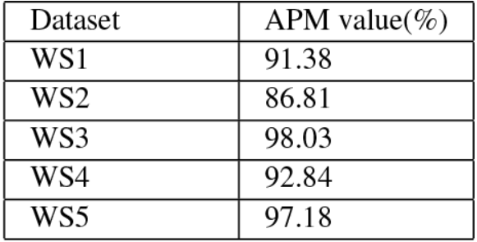
Conclusions
The authors concluded that the lower APM score for WS2 occurred due to the inconsistent changes in performance (P) which made the test plan less effective.
The authors concluded that the APM calculations provided adequate insight into each web service and helped highlight performance faults as they presented themselves.

Slide 14
THANK YOU

